Slide 1
In this section you will learn
Camera settings
Defining heat sources
Factors affecting camera performance
Important considerations

Slide 2
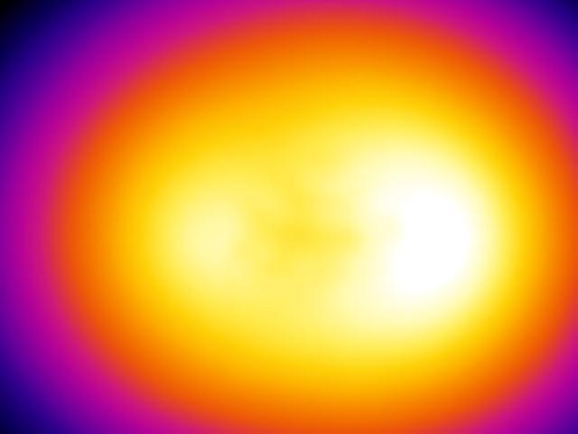
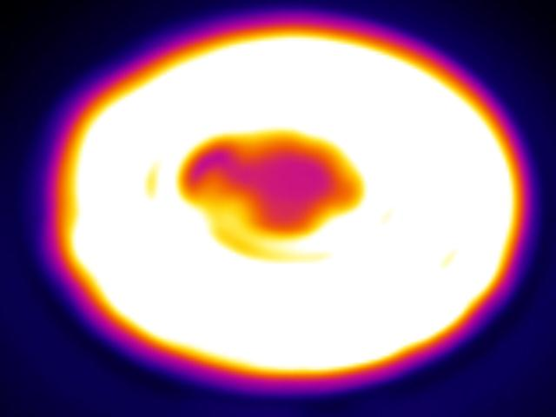
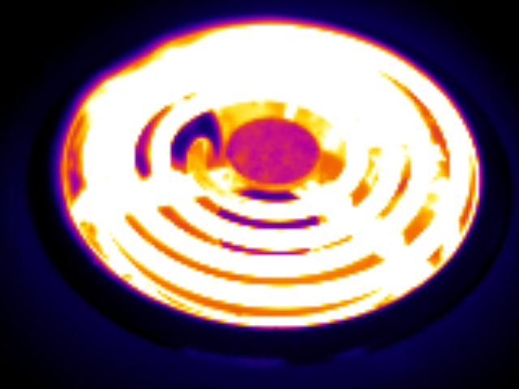
Notes:
Focus

Slide 3
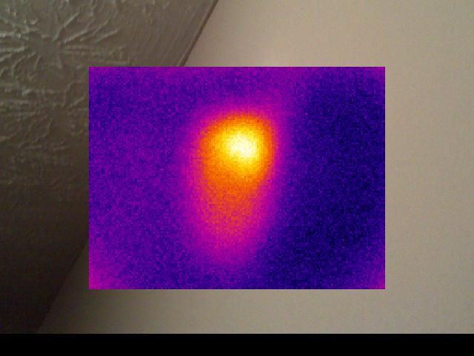
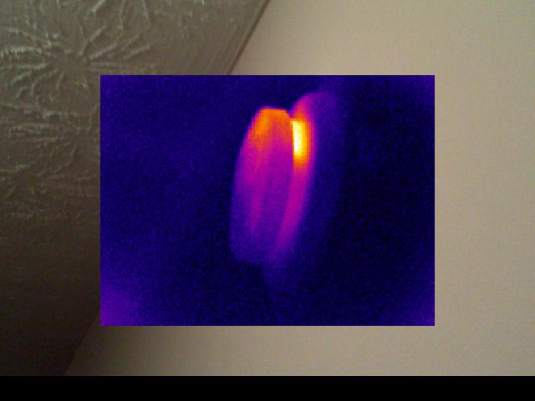
Oh look, a hot spot!!
Never mind, I forgot to focus again!

Slide 4
I trust you get the idea.
Focus is King!

Slide 5
Basic camera setup
Emissivity set at 95%
Auto span, temp is good 90% of the time
Perform a field calibration by measuring the corner of the eye

Slide 6
A Thermographer must be meticulous in defining the heat sources (Sun, HVAC, Lights) and cataloging their activity.
Without a base understanding of the heat sources, interpretation of the images will be difficult.

Slide 7
Temperature difference plays a huge part in thermal imaging. The greater the temperature difference the more heat is transferred.

Slide 8
IR Technology does rely on proper testing conditions.
Temperature difference (inside to outside)
Best conditions occur when the temp. difference is 20 degrees or greater and has been that way for several hours.
Tests are possible with a 10 degree difference.
HVAC system can be used to create or add to the temp. difference.
Mild summer days may generate enough heat in the attic that testing is possible.
Low wind conditions if capturing images of the outside of the home.

Slide 9
A thermographer has to pay attention to the wind. A 10mph wind can reduce DT by up to ½.

Slide 10
Critical knowledge list
Unpack and assemble
Insert and remove memory card
Insert and remove battery
Charging battery
Turn camera on/off
Adjust focus
Use automatic level/span adjustment*
Change palettes*
Turn laser on/off*
Freeze/Unfreeze image. Store/recall image
Change range*
Manually adjust span/level
Turn spot measurement on/off*
Turn image averaging on/off*
Adjust emissivity
Adjust background temperature*
Transfer stored image to laptop*
Pack up equipment (Remember the lens cap!)
* May not be found on all models
Notes:
Insert prompt for Software demo

